Slide 1
Keep Austin Weird,
Not Your SLOE
Jeff Van Dermark MD FACEP Director of UGE
Department of Emergency Medicine UTSW
TCEP
April 25, 2015

Slide 2
Allopathic EM Programs
Emergency Medicine 167
EM/IM 13
EM/IM/Critical Care 4
EM/Peds 4
EM/FM 2

Slide 3
Osteopathic EM Programs
59 Programs with multiple new programs

Slide 4
2015 NRMP DATA
2352 Applicants
1821 PGY-1 Positions
1613 Filled by US Seniors
Notes:
530 didn’t make it. 70% made it

Slide 5
Unfilled spots in EM
2015 7
2014 14
2013 3
2012 0
2011 5
2010 16
2009 13
2008 29
2007 6
2006 33

Slide 6
Why Emergency Medicine?
The art of multi-tasking
Undifferentiated Patient
Shifts - balance / lifestyle
Various career paths
  Community ED
  Academic
    Peds EM
    Toxicology
    EMS
    Wilderness
    Tactical, Disaster
    Global Health
    Educational
    Administrative

Slide 7
Application Process
Electronic Residency Application Service (ERAS)
  Know the dates
Numbers of applications depend on competitiveness of specialty, grades, USMLE/COMLEX scores, and other background of the student
  Advisors will assist

Slide 8
Web Resources
The Primer
  Memorize it
  http://www.saem.org/docs/students/emclership_primer_manual_1.pdf?sfvrsn=2
The Textbook for EM
  Clerkship Directors in EM
  http://www.cdemcurriculum.org
Society for Academic Emergency Medicine SAEM
  http://www.saem.org/membership/medical-students
  Residency Catalog
  Clerkship Catalog
  Student resource pages
American College of Osteopathic Emergency Physicians (ACOEP)
  http://www.acoep.org/pages/gme-res-prog

Slide 9
Web Resources
Emergency Medicine Residents Association http://www.emra.org/Content.aspx?id=280
American College of Emergency Physicians http://www.acep.org/content.aspx?id=42074
American Academy of Emergency Physicians
http://www.aaemrsa.org
VSAS- Visiting Student Application Servichttps://services.aamc.org/20/vsas/
FREIDA
  http://www.ama-assn.org/ama/pub/education-careers/graduate-medical-education/freida-online.page

Slide 10
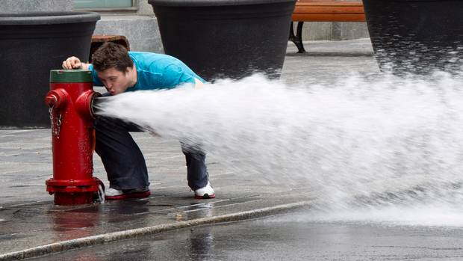
FOAM ME

Slide 11
Don’t Believe Just One Source
Life in the Fast Lane
  http://lifeinthefastlane.com/emergency-medicine-clerkship-primer/
EM Advisor
  http://emadvisor.blogspot.com/
ALiEM
  http://www.aliem.com/em-match-advice-em-rotation-eras-competitive/
Boring EM
  http://boringem.org/2013/01/02/top-10-ways-to-rock-em-clerkship/
  http://boringem.org/2014/08/18/10-tips-from-nurses/

Slide 12
Factors In Getting AN EM Interview
USMLE Step1/COMLEX Level 1 score
MSPE/Dean’s Letter
USMLE Step 2 CK/COMLEX Level 2 CE score
Grades from EM Clerkship
SLOE (s)
Away Rotation

Slide 13
SteP1/COMLEX Level 1
69% want a certain score
31% need it

Slide 14
Step1/CoMlex level 1
Bad
  200-218
  Avg 208
Good
  230-244
  Avg 236

Slide 15
I’m a DO, do I need to take USMLE?
Yes
http://www.ncbi.nlm.nih.gov/pmc/articles/PMC3935778/pdf/wjem-15-101.pdf
Debate on whether Boards are interchangeable

Slide 16
MSPE/Dean’s Letter
Comes out Oct 1
Summary of Clerkship Year
Looking for Red Flags?

Slide 17
Grades in EM Clerkship
Varying Grading Systems
PDs look for the Honors Category
May build into SLOE
How are the tests run?
What makes up the grades?

Slide 18
USMLE Step 2 CK/COMLEX Level 2 CE
22% want a pass rate
54% want a target
25% don’t need one

Slide 19
USMLE Step 2 CK/COMLEX Level 2 CE
Bad
  209-221
  Avg 212
Good
  230-250
  Avg 240

Slide 20
Standardized Letter of Evaluation (SLOE)
Top Factor for PD in granting interviews
Home
Away
Look at template on CORD site
  http://www.cordem.org/files/DOCUMENTLIBRARY/SLOR/SLOE%20Standard%20Letter%20of%20Evaluation%202014.pdf

Slide 21
SLOE
Huge Debate
Group SLOE ideal
Individual SLOE
Can I get 5 of them?
  55% of programs require 1
  36% of programs request at least 1
  6% require more than 1

Slide 22
SLOE
How many students rotate in the course
Grade distribution
Predictions
Global Assessments
Narrative Discussions
Notes:
NOT Under your Control

Slide 23
SLOE
Commitment
Work ethic
Responsibility
Develop and justify differential and cohesive treatment plans
Demonstrate caring nature
High contact
Test results
Narrative
Notes:
Under your control

Slide 24
Why Do an Away…when I have Texas?
11 total EM residencies
  2 Military
  9 Civilian

Slide 25
Should I stay or should I GO?
Away Electives
  Type
  Setting
  Reponsibilities
  Are you going to give me a good SLOE??!!!??

Slide 26
Away Electives
VSAS
Check program website if not in VSAS
More than one away EM?
Valuable Rotations
  Toxicology
  Ultrasound
  EMS
  Advanced EM electives

Slide 27
VSAS
Permissions through your medical school
Catalogs open
  Now through spring
Applications accepted
  Variable but typically March 1 and on
  https://services.aamc.org/20/vsas/public/schools/

Slide 28
What should my year look like?
July
Aug
Oct
Nov
Dec
Sept
Interview
Home
Away
Helpful
Helpful
Helpful

Slide 29
References
2015 NRMP Advanced Data Table
  http://www.nrmp.org/wp-content/uploads/2015/03/ADT2015_final.pdf
2014 NRMP Program Director Survey
  http://www.nrmp.org/2014-program-director-survey-report-now-available/

Slide 30
Thanks for Participating
Questions?

